Slide 1
Why PostgreSQL (pgvector)
Pinecone
Weaviate
ChromaDB
Milvus
Vespa

Slide 2
Specialized vector DBs
= Extra complexity
Hard to integrate with relational/metadata
Vendor lock-in and cost concerns
Handles structured + vector + text
Mature, reliable, ACID compliant
Open-source, cost-effective
Runs everywhere (local, cloud, containers)

Slide 3
Unified Queries
SELECT *
FROM documents
WHERE metadata->>'category' = ‘hr_policy’
ORDER BY embedding <#> query_vector
LIMIT 5;
SQL + Vectors + Metadata

Slide 4
Vector Indexes
HNSW
IVFFlat
Deployment Advantage
Docker + pgvector setup
Storage
Health
Initialization

Slide 5
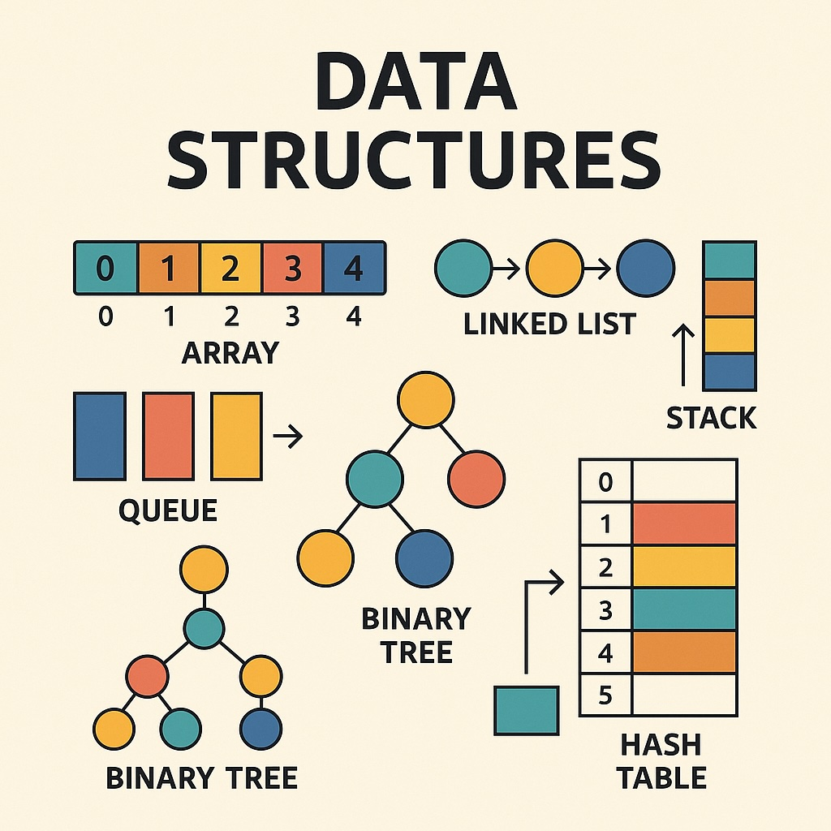
Vector Indexes
[-0.1848554 -0.17605719
0.18991971 0.4797751
0.04560479 0.00489019
0.0982461 -0.07267588]
Vector
Store
Vectorization
Embedding
Model
Retrieval
Relevant Data
Build
Fast
Efficient

Slide 6
PGVector
IVFFlat
Inverted File Flat
HNSW
Hierarchical Navigable Small World

Slide 7
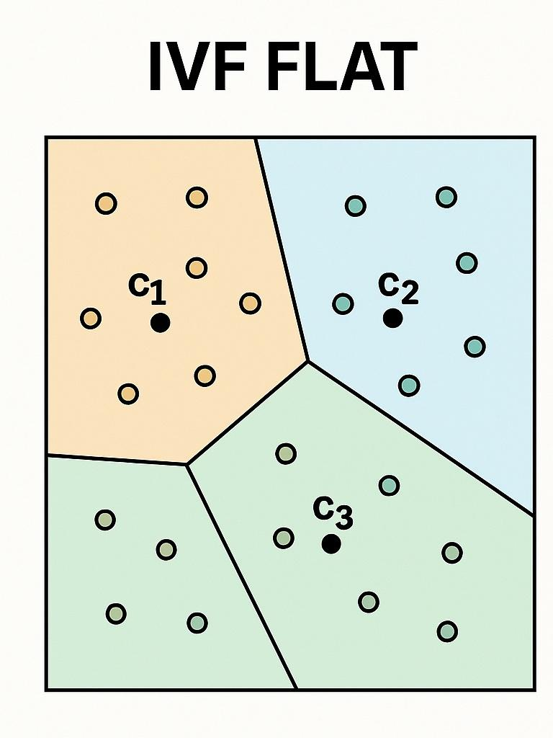

Memory-Constrained
Fast Builds
Trade Accuracy
Temp or Experimental

Slide 8
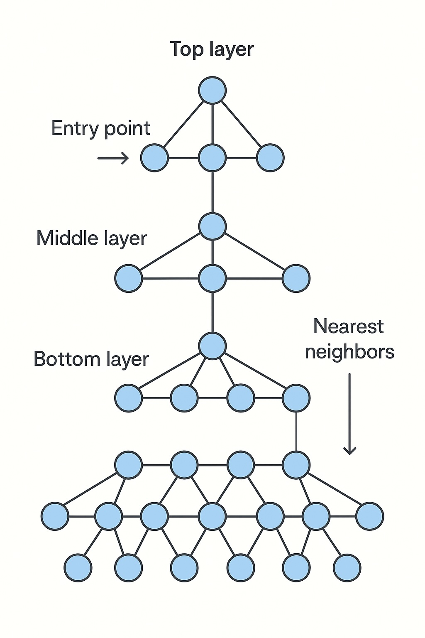
HNSW
Best Recall
Fast Queries
Production Scale

Slide 9
Caching
[-0.1848554 -0.17605719
0.18991971 0.4797751
0.04560479 0.00489019
0.0982461 -0.07267588]
Vector
Store
Prompt
Embedding
Model
}
Relevant Data
Prompt
+
+
Relevant
Data
Response
Cached
Cache
DB
Semantic
LLM

Slide 10
[-0.1848554 -0.17605719
0.18991971 0.4797751
0.04560479 0.00489019
0.0982461 -0.07267588]
Vector
Store
Prompt
Embedding
Model
}
Relevant Data
Cached Response
Prompt
+
Relevant
Data
Cache
DB
Semantic
REDIS

Slide 11
RAG Process
[-0.1848554 -0.17605719
0.18991971 0.4797751
0.04560479 0.00489019
0.0982461 -0.07267588]
Vector
Store
Prompt
Embedding
Model
Relevant Data
Prompt
+
Relevant
Data
Response
LLM

Slide 12
RE-Ranking
Prompt
Prompt
+
Relevant
Data
Re-Ranking
Model
LLM

Slide 13
Types
Simple Similarity Scores
Cross-Encoder Reranking
Cohere Rerank
LLM-based Reranking

Slide 14
Evals
Measure
Compare
Improve
[-0.1848554 -0.17605719
0.18991971 0.4797751
0.04560479 0.00489019
0.0982461 -0.07267588]
Vector
Store
Prompt
Embedding
Model
Relevant Data
Prompt
+
Relevant
Data
Response
Right Context
Relavent
Faithful
LLM

Slide 15
RAGAS
Metrics
Faithfulness
Question
Answer
Answer Relevancy
Contexts
Context Precision
Reference Answer
Context Recall

Slide 16
Metadata
[-0.1848554 -0.17605719
0.18991971 0.4797751
0.04560479 0.00489019
0.0982461 -0.07267588]
Chunk
Vector
Store
Data About Data
Metadata
Author
Prompt
Embedding
Model
Category
Metadata
Department
Relevant Data
Prompt
+
Relevant
Data
Response
LLM

Slide 17
Semantic Search
Precise
Targeted
Context Aware
Common Metadata
Source Information
File Name
Url
Categorical Tags
Department
Doc Type
Timestamps
Created_At
Last_Updated
Custom Fields
Category
Version

